Slide 1
Page Replacement
In an operating system that uses paging for memory management, a page replacement algorithm is needed to decide which page needs to be replaced when new page comes in.
Page Fault – A page fault happens when a running program accesses a memory page that is mapped into the virtual address space, but not loaded in physical memory.
Since actual physical memory is much smaller than virtual memory, page faults happen. In case of page fault, Operating System might have to replace one of the existing pages with the newly needed page. Different page replacement algorithms suggest different ways to decide which page to replace. The target for all algorithms is to reduce the number of page faults.

Slide 2
Segmentation
Memory management scheme that supports user view of memory
A program is a collection of segments
A segment is a logical unit such as:
Main program, function, object, common block, symbol table, procedure, method
local variables, global variables, stack ,array

Slide 3
Logical view of segmentation
User space Physical memory space
1
4
1
2
3
2
4
3

Slide 4
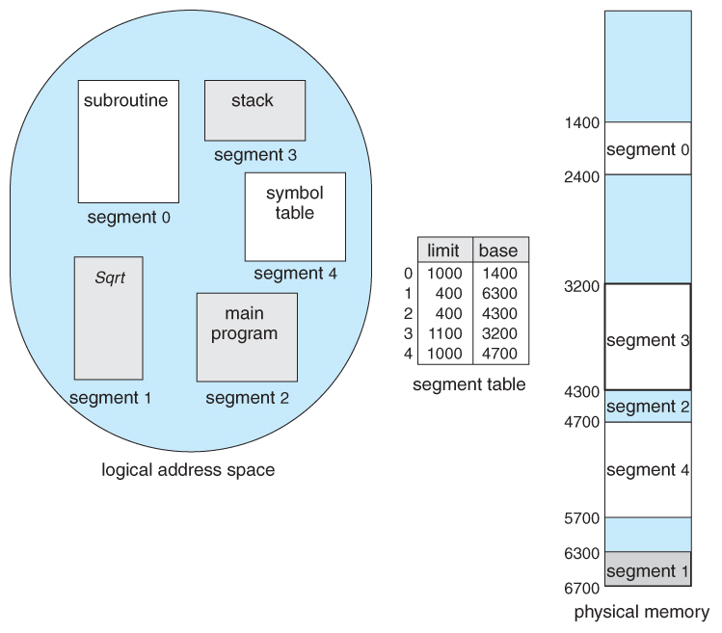

Slide 5
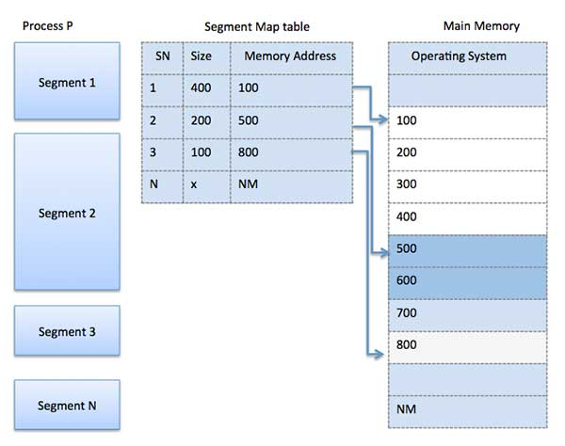

Slide 6
Segmentation is a memory management technique in which each job is divided into several segments of different sizes, one for each module that contains pieces that perform related functions.
Each segment is actually a different logical address space of the program.
When a process is to be executed, its corresponding segmentation are loaded into non-contiguous memory though every segment is loaded into a contiguous block of available memory.
Segmentation memory management works very similar to paging but here segments are of variable-length where as in paging pages are of fixed size.

Slide 7
A program segment contains the program's main function, utility functions, data structures, and so on.
The operating system maintains a segment map table for every process and a list of free memory blocks along with segment numbers, their size and corresponding memory locations in main memory.
For each segment, the table stores the starting address of the segment and the length of the segment. A reference to a memory location includes a value that identifies a segment and an offset.

Slide 8
Paging | Segmentation
In paging, program is divided into fixed or mounted size pages. | In segmentation, program is divided into variable size sections.
For paging operating system is accountable. | For segmentation compiler is accountable.
Page size is determined by hardware. | Here, the section size is given by the user.
It is faster in the comparison of segmentation. | Segmentation is slow.
Paging could result in internal fragmentation. | Segmentation could result in external fragmentation.

Slide 9
In paging, logical address is split into page number and page offset. | Here, logical address is split into section number and section offset.
Paging comprises a page table which encloses the base address of every page. | While segmentation also comprises the segment table which encloses segment number and segment offset.
Page table is employed to keep up the page data. | Section Table maintains the section data.
In paging, operating system must maintain a free frame list. | In segmentation, operating system maintain a list of holes in main memory.
Paging is invisible to the user. | Segmentation is visible to the user.

